Slide 1


HOUSE APPRAISAL SYSTEM
Dept.of Computer Science & Engg.
Guided By :
Ms.Nisna Haneefa K
Assistant Professor,
Dept. of CSE
Presented By : Group 15
ABIJITH.G - JCE22CS002
ASWIN.S - JCE22CS018
ASWIN P.S - JCE22CS017 YADUKRISHNAN T.M - JCE22CS066
S6 B.Tech, 2022-26 Batch CSD334 Mini Project External Review Tuesday, April 22
1

Slide 2
INTRODUCTION
Dept.of Computer Science & Engg.
Housing is a fundamental necessity, providing shelter and livelihood alongside other basic needs like food and water.
Rising living standards have increased housing demand, with most people seeking homes as a place to live rather than for investment.
Housing markets boost economies by driving demand for goods, construction materials, and related industries, creating a ripple effect.
Housing is recognized as a human right, with a strong housing supply reflecting economic growth and stability.
S6 B.Tech, 2022-26 Batch CSD334 Mini Project External Review Tuesday, April 22
2

Slide 3
ABSTRACT
Dept.of Computer Science & Engg.
The project aims to develop a machine learning-based model to predict housing prices accurately, considering various parameters such as buyer preferences, budgets, and market trends, to assist customers in making informed decisions.
Machine learning algorithms like Random Forest Regression, Linear Regression, Decision Tree Regression, and K-Means Regression are employed for data collection, preprocessing, and predicting real estate prices.
This project addresses the challenges of the dynamic real estate market by providing efficient, cost-effective, and accurate housing price predictions, empowering buyers to make better financial decisions without needing a broker.
S6 B.Tech, 2022-26 Batch CSD334 Mini Project External Review Tuesday, April 22
3

Slide 4
LITERATURE REVIEW
Dept.of Computer Science & Engg.
Title and Author name
Methodology
Merits and Demerits
Relevance
Title and Author name | Methodology | Merits and Demerits | Relevance
“Advanced Machine Learning Algorithms for House Price Prediction” -Ayush Chauhan, Anubhav Singh - | Uses Support Vector Regression (SVR), Artificial Neural Networks (ANN), and Linear Regression to predict house prices. | Merits: Explores multiple ML models for price prediction. Feature selection improves accuracy. Demerits: May not work well for all datasets. Limited deep learning integration. | Useful for understanding traditional ML-based price prediction.
B
S6 B.Tech, 2022-26 Batch CSD334 Mini Project External Review Tuesday, April 22
4

Slide 5
LITERATURE REVIEW
Dept.of Computer Science & Engg.
Title and Author name
Methodology
Merits and Demerits
Relevance
Title and Author name | Methodology | Merits and Demerits | Relevance
2.”House Price Prediction Using Machine Learning”-Prof.J.Kalidass, T.Dharshalini, R.Nivetha, AP.Subasri. | Uses Random Forest, Decision Tree, and XGBoost for price estimation. | Merits: High accuracy with XGBoost. Effective handling of missing values. Demerits: Computationally expensive for large datasets. | Highlights the importance of ensemble learning for price predictions.
B
S6 B.Tech, 2022-26 Batch CSD334 Mini Project External Review Tuesday, April 22
5

Slide 6
LITERATURE REVIEW
Dept.of Computer Science & Engg.
Title and Author name
Methodology
Merits and Demerits
Relevance
Title and Author name | Methodology | Merits and Demerits | Relevance
3.”House Price Prediction via Visual Cues and Estate Attributes”- Sai Surya Vaddi, Amir Yousif, Samah Baraheem, Ju Shen, Tam V.Nguyen. | Uses Convolutional Neural Networks (CNNs) and textual data to improve price prediction. | Merits: Enhances accuracy with image-based features. Novel approach combining visual and textual data. Demerits: Requires large datasets for deep learning. High computational cost. | Useful for AI-driven real estate applications.
B
S6 B.Tech, 2022-26 Batch CSD334 Mini Project External Review Tuesday, April 22
6

Slide 7
LITERATURE REVIEW
Dept.of Computer Science & Engg.
Title and Author name
Methodology
Merits and Demerits
Relevance
Title and Author name | Methodology | Merits and Demerits | Relevance
4.”Prediction of House Prices Using Machine Learning” -Nisha Dhaka, Avantika Chaudary, Dhrithi Sisodia, Mayank Sharma, Satish Babu. | Uses Multiple Regression and Random Forest for price estimation. | Merits: Random Forest improves prediction reliability. Feature engineering enhances performance. Demerits: Limited exploration of deep learning methods. | Practical for applying regression and ensemble models in real estate.
B
S6 B.Tech, 2022-26 Batch CSD334 Mini Project External Review Tuesday, April 22
7

Slide 8
EXISTING SYSTEM
Dept.of Computer Science & Engg.
Traditional methods rely on manual calculations, leading to errors and inefficiencies.
Real estate experts provide forecasts through blogs and magazines, which are not data-driven.
House price prediction models often overlook future market trends, leading to price fluctuations.
Current systems fail to account for future market trends, resulting in price fluctuations.
Lack of machine learning-based forecasting tools in some markets hampers accurate price prediction.
Buyers face difficulties finding properties within their budget and preferred parameters.
S6 B.Tech, 2022-26 Batch CSD334 Mini Project External Review Tuesday, April 22
8

Slide 9
PROPOSED SYSTEM
Dept.of Computer Science & Engg.
User Input: Users can enter house details (e.g., number of rooms, square footage, location).
Prediction Engine: Uses regression models (e.g., Linear Regression, Random Forest, or Neural Networks) to estimate prices.
Visualization: Displays trends, price distributions, and comparisons.
API Integration: Allows integration with real estate platforms for enhanced data insights.
Feedback System: Users can report inaccuracies to improve model accuracy over time.
S6 B.Tech, 2022-26 Batch CSD334 Mini Project External Review Tuesday, April 22
9

Slide 10
METHODOLOGY
Dept.of Computer Science & Engg.
The project employs machine learning algorithms such as Linear Regression, Decision Tree, K-Means, and Random Forest to predict house prices.
Datasets from Kaggle are used for training and testing the models, with 80% of data for training and 20% for testing.
Data collection from reliable sources like Kaggle, focusing on features like location, size, and amenities.
Exploratory Data Analysis (EDA) to identify trends and correlations using visualizations.
Input parameters like locality, number of rooms, and floors are used to predict house prices.
The project is designed as a web application, allowing users to access predictions in real-time.
S6 B.Tech, 2022-26 Batch CSD334 Mini Project External Review Tuesday, April 22
10

Slide 11
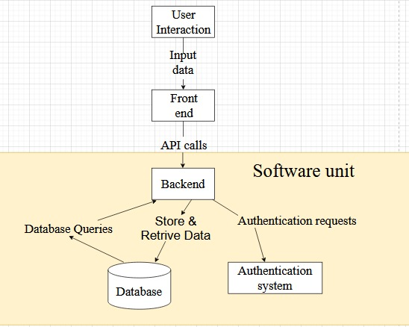
SYSTEM ARCHITECTURE
Dept.of Computer Science & Engg.
.
S6 B.Tech, 2022-26 Batch CSD334 Mini Project External Review Tuesday, April 22
11

Slide 12
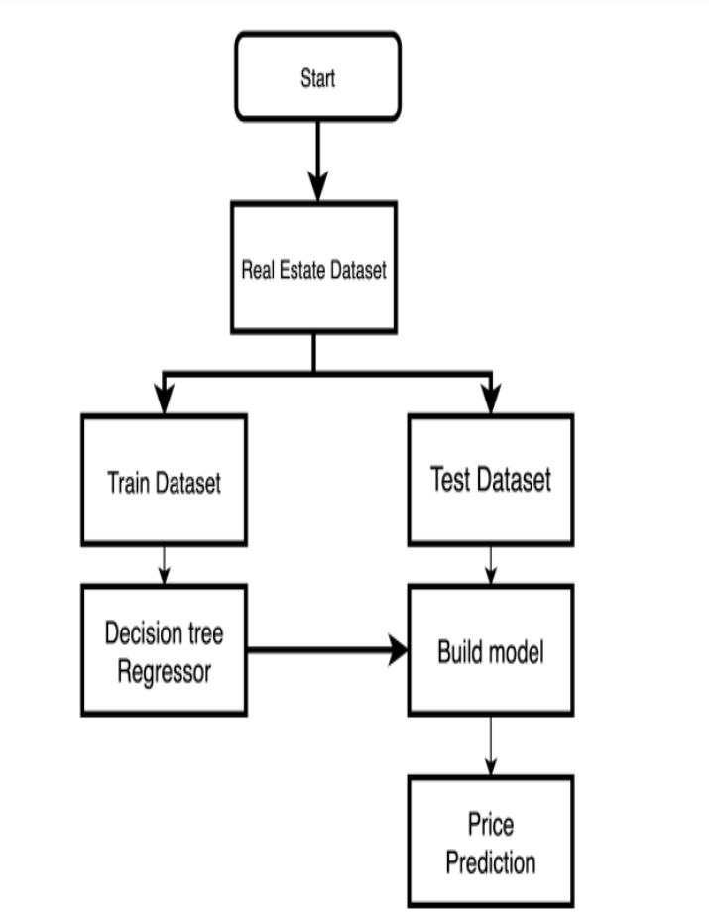
DATAFLOW DIAGRAM
Dept.of Computer Science & Engg.
.
S6 B.Tech, 2022-26 Batch CSD334 Mini Project External Review Tuesday, April 22
12

Slide 13
STAKEHOLDERS
Dept.of Computer Science & Engg.
Homebuyers & Sellers:
Use the system to estimate property values for informed buying or selling decisions.
Real Estate Agents:
Leverage predictions to guide pricing strategies and negotiations with clients.
Data Scientists/ML Engineers:
Develop, train, and optimize machine learning models for accurate price forecasting.
Investors & Real Estate Agencies:
Utilize predictions for making data-driven investment decisions and market analysis.
Data Providers & Tech Companies:
Supply data and build the platform/infrastructure to support the prediction system.
S6 B.Tech, 2022-26 Batch CSD334 Mini Project External Review Tuesday, April 22
13

Slide 14
SYSTEM REQUIREMENTS
Dept.of Computer Science & Engg.
Hardware Requirements:
Processor: i5 7th Gen or higher.
Memory: 4 GB RAM or more.
Storage: 128 GB SSD or equivalent.
Graphics Card: 4 GB (optional for visualization).
Software Specifications:
Programming Language: Python (for machine learning and web development).
ML Libraries: Pandas, Numpy, Matplotlib, Scikit-learn
Development Platform: Jupyter Notebook, Co-lab
Web Framework: Flask for application deployment.
Hosting Platform: Heroku for deploying the web application.
Version Control: GitHub for collaboration and progress tracking.
Additional Tools: HTML, CSS for front-end development.
S6 B.Tech, 2022-26 Batch CSD334 Mini Project External Review Tuesday, April 22
14

Slide 15
TIMELINES
Dept.of Computer Science & Engg.
Schedule :
Phase | Duration | Tasks
Planning and Design | 2 weeks | Features and Requirement gathering
Development | 3-4 weeks | Frontend and Backend coding in Parallel
Testing and Integration | 1 week | Debugging and Modification
Presentation | 1-2 weeks | Final report, demo Preparation.
S6 B.Tech, 2022-26 Batch CSD334 Mini Project External Review Tuesday, April 22
15

Slide 16
ROLES
Dept.of Computer Science & Engg.
Data Analyst : Aswin S
Front-end : Abijith G
Tester : Aswin PS
Debugger : Yadukrishnan TM
S6 B.Tech, 2022-26 Batch CSD334 Mini Project External Review Tuesday, April 22
16

Slide 17
CONCLUSION
Dept.of Computer Science & Engg.
House price prediction using machine learning enables consumers to purchase a home on a budget and avoid financial ruin.
Additional features were included in the dataset to help predict the prices even better. These additional features influence people’s decisions when purchasing a property.
To differentiate our model from previous prediction systems, we must include other parameters such as taxation and air quality.
S6 B.Tech, 2022-26 Batch CSD334 Mini Project External Review Tuesday, April 22
17

Slide 18
REFERENCE
Dept.of Computer Science & Engg.
Chauhan, A., & Singh, A. (2023). Advanced machine learning algorithms for house price prediction. The Science and Information Organization. Retrieved from https://thesai.org/Downloads/Volume12No12/Paper_91-Advanced_Machine_Learning_Algorithms.pdf
IRJET. (2023). House price prediction using machine learning. International Research Journal of Engineering and Technology (IRJET), 11(4), 226. Retrieved from https://www.irjet.net/archives/V11/i4/IRJET-V11I4226.pdf
Engström, A. I. (2019). Predicting house prices with machine learning methods. Diva Portal. Retrieved from https://www.diva-portal.org/smash/get/diva2%3A1354741/FULLTEXT01.pdf
Vaddi, S. S., Yousif, A., Baraheem, S., Shen, J., & Nguyen, T. V. (2022). House price prediction via visual cues and estate attributes. National Science Foundation. Retrieved from https://par.nsf.gov/servlets/purl/10428263
Dhaka, N., Chaudhary, A., Sisodiya, D., Sharma, M., & Babue, S. (2023). Prediction of house prices using machine learning. Propulsion Tech Journal. Retrieved from https://www.propulsiontechjournal.com/index.php/journal/article/download/5998/3970/10311
G., A., Dattatray, S., G., S., & Bharadi, V. K. (2021). House price prediction using machine learning.
Ahtesham, M., Bawany, N. Z., & Fatima, K. (2020). House price prediction using machine learning algorithm: The case of Karachi city, Pakistan. IEEE.
S6 B.Tech, 2022-26 Batch CSD334 Mini Project External Review Tuesday, April 22
18

Slide 19
THANK YOU
Dept.of Computer Science & Engg.
K
S6 B.Tech, 2022-26 Batch CSD334 Mini Project External Review Tuesday, April 22
19

